Slide 1

Why you should learn Power Query ?
What is Power Query ?
->To Save 50% of your daily routine time
->Refresh and repeat the steps created
ETL tool used for cleaning the data
i.e. Extract Data from Data Source ,
Transform it in Power Query and Load
Back to excel.
->Power Query is a Combination of multiple
software’ i.e. EXCEL , SQL and VBA
LIFE CHANGING TOOL

Slide 2

IMPORTING DATA FROM DIFFERENT SOURCES

Slide 3
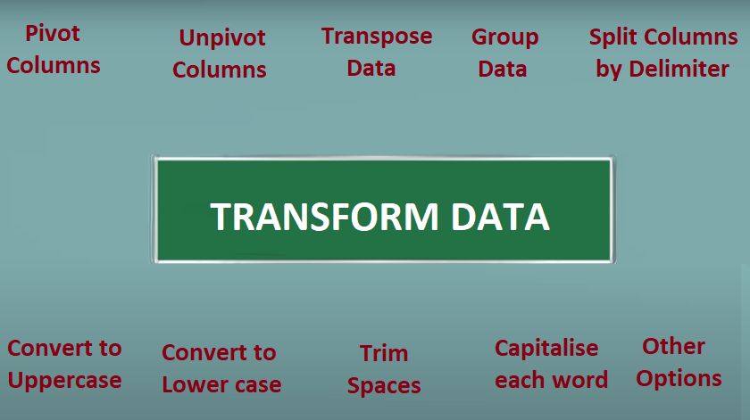

Slide 4
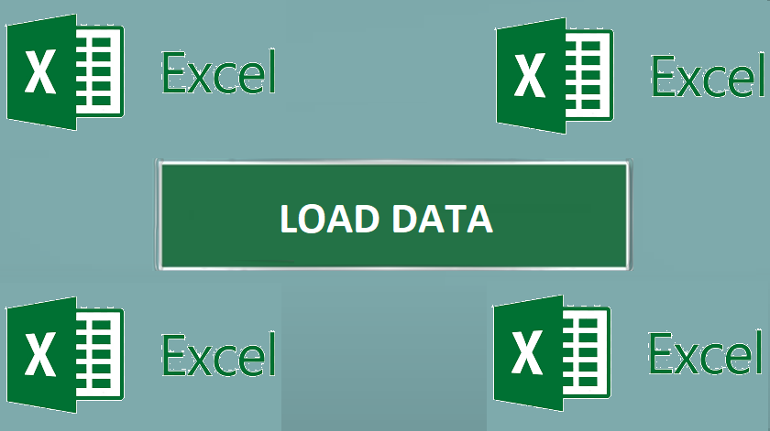

Slide 5
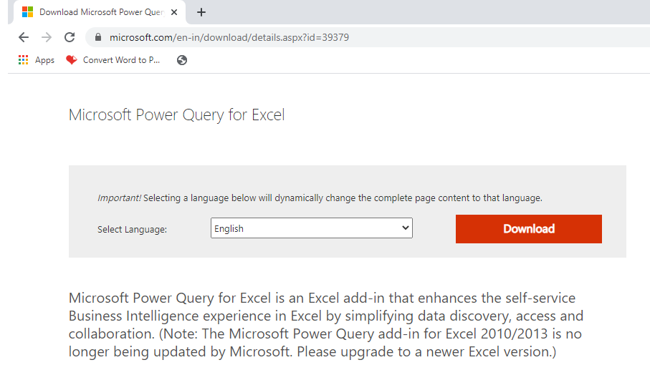
Power Query is a Free Excel Add in by Microsoft built in by default in Excel 2016 , 2019
,Office 365 and Power BI
Separate Free Power Query Installation Add in available for Office 2010 and Office 2013
Able to append bunch of excel tables , excel files , CSV files and sql tables in few button clicks
100+ excel functions can be replaced by Power Query with a button clicks and less use of keyboard
Without using any function and keyboard in power query you can get the vlookup answer.

Slide 6
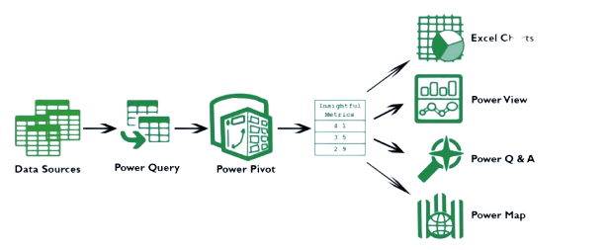
Charts

Slide 7
